Slide 1
Python session Operators and Functions - Dhilip Kumar (software Engineer at Intelizign)

Slide 2
Table of Content
Operators in python
Arithmetic operator
Assignment operator
Comparision operator
Logical operator
Identity operator
Membership operator
Bitwise operator
All about Function
What is Function
Functions syntax and structure
Types of Function
Solution discussion

Slide 3
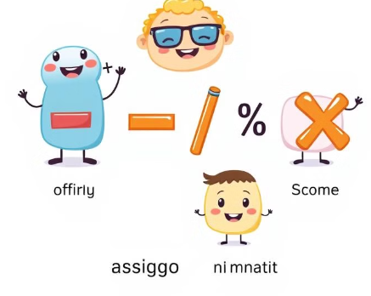
1. Operator in Python
Arithmetic Operators
Arithmetic operators perform mathematical calculations on numbers. Examples include addition (+), subtraction (-), multiplication (*), division (/), modulo (%), floor division (//), and exponentiation (**).
Addition (+)
Adds two operands.
Subtraction (-)
Subtracts the second operand from the first.
Multiplication (*)
Multiplies two operands.

Slide 4
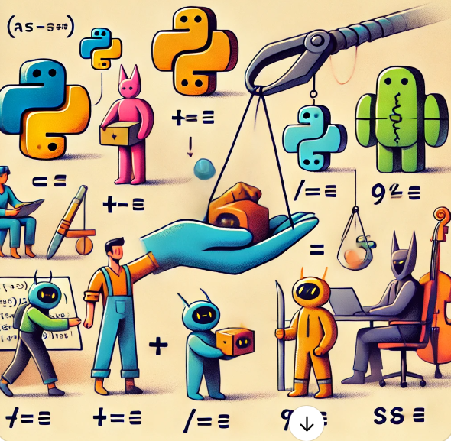
1. Operator in Python
Assignment Operators
Assignment operators are used to assign values to variables. The basic assignment operator is =, while others combine assignment with an arithmetic operation.
Equal to (=)
Assigns the value on the right to the variable on the left.
Plus Equal to (+=)
Adds the right operand to the left operand and assigns the result to the left operand.
Minus Equal to (-=)
Subtracts the right operand from the left operand and assigns the result to the left operand.
Multiply Equal to (*=)
Multiplies the right operand with the left operand and assigns the result to the left operand.

Slide 5
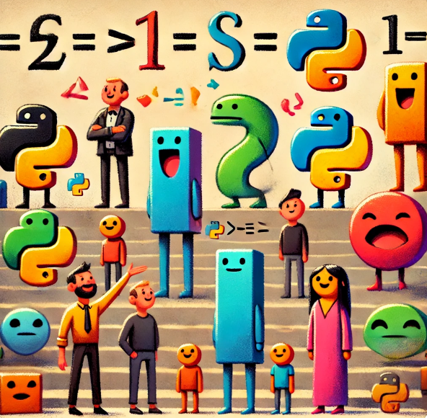
1. Operator in Python
Comparison Operators
Comparison operators compare values and return a Boolean result, either True or False. These operators are used for conditional statements and loops.
Operator | Description
== | Equal to
!= | Not equal to
> | Greater than
< | Less than
>= | Greater than or equal to
<= | Less than or equal to

Slide 6
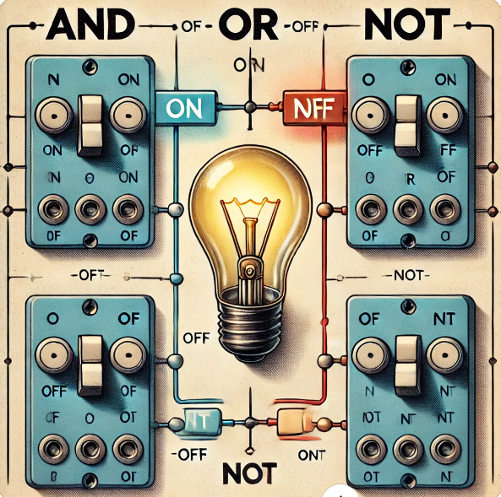
1. Operator in Python
Logical Operators
Logical operators combine Boolean expressions and return a Boolean result. They are used to create complex conditions and control program flow.
and
Returns True if both operands are True.
or
Returns True if at least one

Slide 7
1. Operator in Python
Identity Operators
Identity operators check if two operands refer to the same object in memory. They are used to determine if variables point to the same location in memory.
is
Returns True if both operands refer to the same object.
is not
Returns True if both operands refer to different objects.

Slide 8

1. Operator in Python
Membership Operators
Membership operators check if a value exists within a sequence, such as a string, list, or tuple.
in
Returns True if the first operand is found within the second operand.
not in
Returns True if the first operand is not found within the second operand.

Slide 9
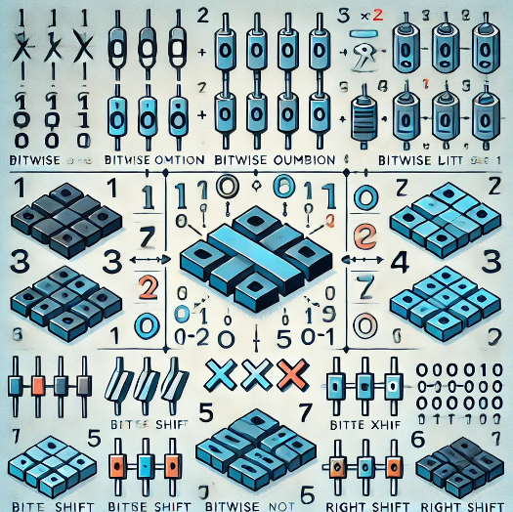
1. Operator in Python
Bitwise Operators
Bitwise operators work on individual bits of data. They are useful for manipulating binary data, working with flags, and optimizing code.
AND (&)
Performs a bitwise AND operation. It returns a 1 in each bit position where both operands have a 1.
OR (|)
Performs a bitwise OR operation. It returns a 1 in each bit position where at least one operand has a 1.
XOR (^)
Performs a bitwise XOR operation. It returns a 1 in each bit position where only one operand has a 1.
NOT (~)
Performs a bitwise NOT operation. It inverts the bits of the operand.

Slide 10
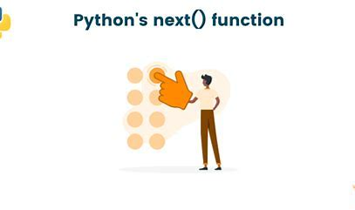
2. All about Functions
A Python function is a reusable block of code that performs a specific task. It helps organize code, improves readability, and promotes code reusability.
Modularity
Functions break down complex programs into smaller, manageable parts.
Reusability
Functions can be called multiple times, saving time and effort.
Readability
Well-structured code with functions is easier to understand and maintain.
Debugging
Functions isolate errors, making it easier to identify and fix problems.

Slide 11
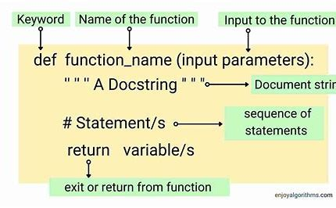
2. All about Functions
Functions syntax and structures

Slide 12
2. All about Functions
Types of functions
Built-in Functions
Predefined functions provided by Python, such as print(), len(), and input().
User-defined Functions
Functions created by the programmer to perform specific tasks. These are essential for code organization.
Lambda Functions
Anonymous functions defined using the 'lambda' keyword, suitable for short, concise functions.
Recursive Functions
Functions that call themselves within their own definition, used to solve problems that can be broken down into smaller, similar subproblems.

Slide 13
2. All about Loops
Use case – Fruit Market using For Loops
I am at the fruit market I love to buy some mango until my bag get occupied.
I have some condition - I need to pick raw mango instead of ripe one because I will eat after two days.

Slide 14
2. All about Loops
Use Case: ATM Withdrawal System
Imagine an ATM withdrawal system where a myself can attempt to withdraw money multiple times. Constrain:
I can attempt up to three times.
System will skip the attempt if the withdrawal amount is zero or negative.
System will stop withdrawal if amount exceeds the account balance.

Slide 15
Question and Answer

Slide 16
Thank you

